Slide 1
Project REToken
Fractional Investment of Real Estate
Batch 3 Group 7
Mei Xuan
Soh Har
Travis

Slide 2
OUR MISSION VISION & VALUE PROPOSITION
VALUE PROPOSITION
MISSON
VISION
Level Playing Field for All Investors in Real Estate Investment
Unleash Value from
Fractional Investment of
Real Estate
Democratize Access to Real Estate Investment

Slide 3
WHY IS WORTH LOOKING INTO IT?
USD228T
Largest Asset Class
Increasing appetite for RE investment
USD830B
Invested
Disproportionate Investors
Notes:
At USD228 trillion (according to RCA), real estate is the largest asset class in the world, it is more valuable than bonds and stocks combined
Despite the enormous market size, global commercial real estate investment only reached USD830 billion in 2019 (according to CBRE), account for only 0.3% of the total asset value
Over 90% of investors in primary market are institutional or accredited investors (according CRE report)
Increasing demand from new investors for increased access and from existing investors for greater liquidity gives an impetus to transform the real estate investment landscape

Slide 4
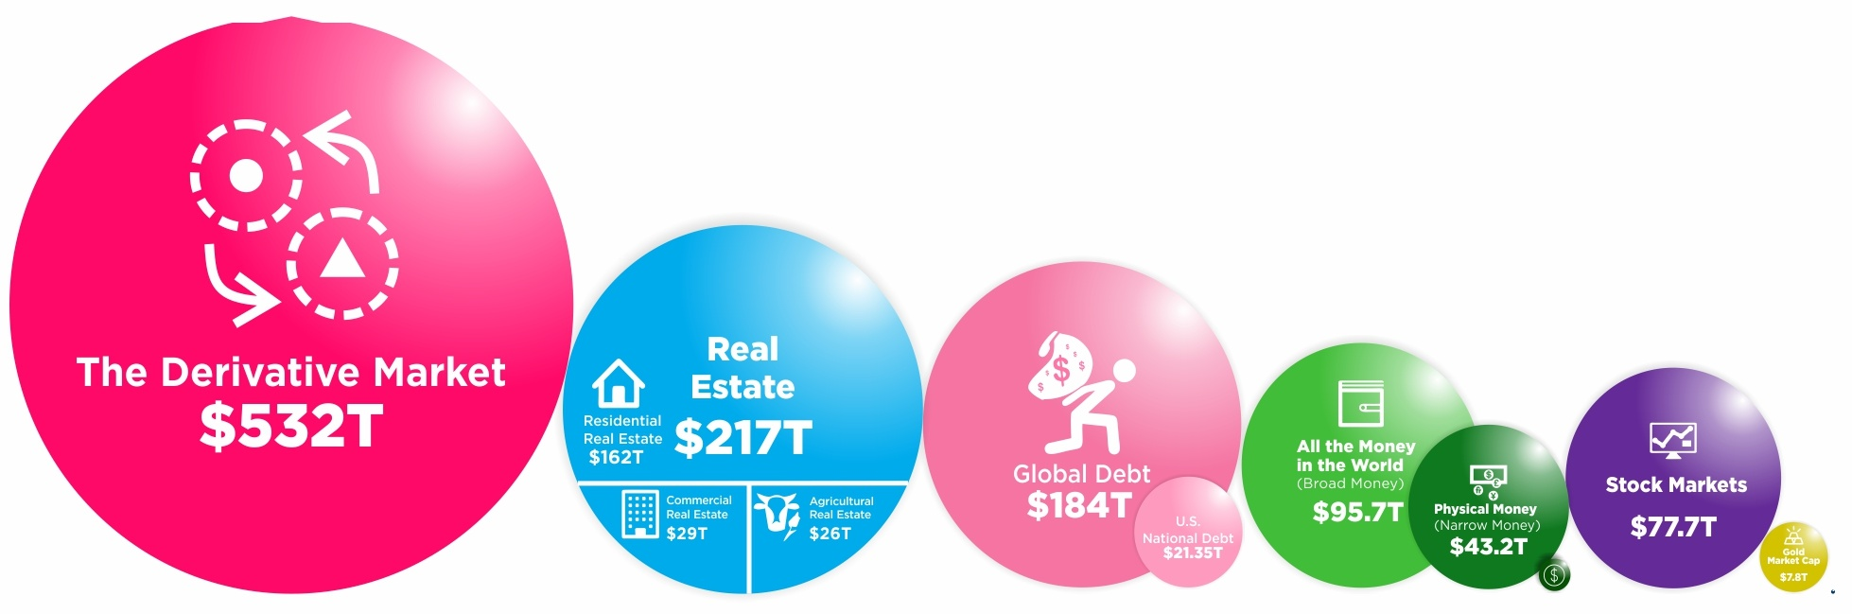
WHY IS WORTH LOOKING INTO IT?
Source: https://howmuch.net/articles/visualizing-the-biggest-economic-bubbles (dated 22 January 2019)
Notes:
At USD228 trillion (according to RCA), real estate is the largest asset class in the world, it is more valuable than bonds and stocks combined
Despite the enormous market size, global commercial real estate investment only reached USD830 billion in 2019 (according to CBRE)
Over 90% of investors in primary market are institutional or accredited investors (according CRE report)
Increasing demand from new investors for increased access and from existing investors for greater liquidity gives an impetus to transform the real estate investment landscape

Slide 5
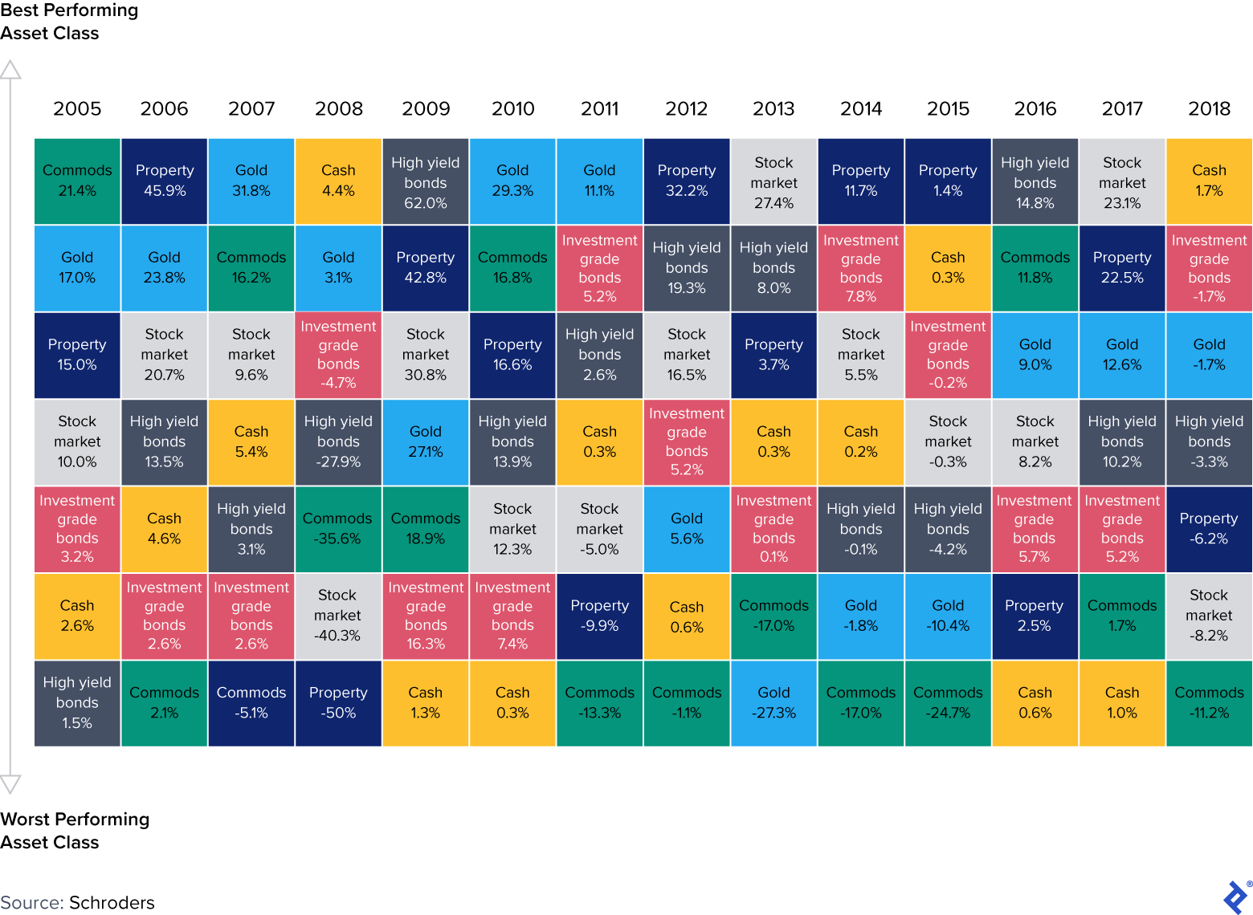
WHY IS WORTH LOOKING INTO IT?
Real Estate asset class leads performance ranking in 3 out of the 9 years between 2010 and 2018, coming in second or third on three other occasions

Slide 6
WHAT ARE THE PROBLEMS?
ILLIQUID ASSET
Real estate is one of the most illiquid asset class
TOO MANY INTERMEDIARIES
Large number of intermediaries
e.g. lawyers, brokers, bankers, financial institution
HIGH BARRIERS TO ENTRY
High capital requirements,
not all investors have the same access to information

Slide 7
EXISTING BUSINESS MODELS & THEIR EFFECTIVENESS
REITS
Listed RE Co.
Private Investment
Time-consuming listing process
Expensive (10% - 20%)
Not accessible by single asset owners
Some intermediaries
Time-consuming listing process
Expensive (5% - 10%)
Not accessible by single asset owners
Many intermediaries
Opaque Information
Opaque Information
Market Accessiiblity
Illiquid
Regulatory Compliancy
Some intermediaries
Notes:
Large commercial properties are good examples of illiquid assets as each property is unique (lack of standardization) and requires large upfront investment. The transaction period for such investments are long, and once invested the owner tends to hold the asset for a prolonged period due to high transaction costs. A typical timeline from finding a property to closing the transaction can be anywhere from 6 months to 2 years, and the transaction fees range from 1% to 3% of the asset value.
Publicly traded Real Estate Investment Trusts (REITs) are one option of liquid real estate investments. However, the process to offer and list a REIT in most of the established exchanges in the world is time consuming and generally takes more than 2 years of planning. It can also be expensive, with costs ranging from 3% to 10% of the market value of the assets, which translates to costs of up to several million dollars. Using a REIT to provide liquid real estate investment is not a feasible option for owners of a single asset or a small portfolio of assets.
In contrast, tokenization is ideal for owners of a single asset or a small portfolio of assets, due to the significant reduction of time and cost in offering investors the right to participate in fractional ownership and subsequent secondary trading.

Slide 8
IDEAL COMMERCIAL PRODUCT
01
02
03
TOKENIZATION & FRACTIONALIZATION
PRIMARY & SECONDARY MARKET
ADMIN, OWNER, INVESTOR DASHBOARDS
04
05
06
FREE CONSULTATION
MONETIZATION
ECOSYSTEM
Notes:
Enables the fractionalization of the asset, making it more accessible to the mass market and allow the asset owners to issue tokens to the asset for financing purposes
Primary Market (Owner to Investor). Secondary Market (Investor to Investor, provides liquidity for the token holders)
Admin (Provides Admin with direct access to tools for more efficient management), Owner (Provides overview of tokenized assets and pending actions), Investor (Provides one-stop view on investor’s portfolio)
No obligations consultation (online or in-person) to increase awareness and adoption of service
Primary (Tokenization fee, Transaction fee). Secondary (Ads, E.g. Developer, Other alternative investment)
Collaborate and support other services that provide Digital Titles, Digital Leases, Security Token List to allow frictionless onboarding and reduced cost

Slide 9

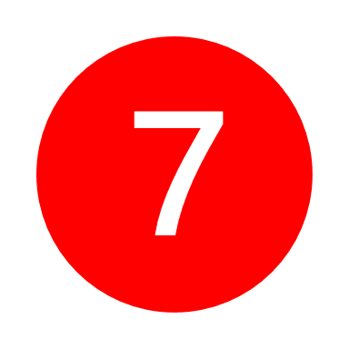





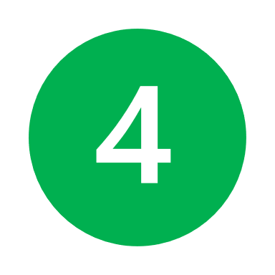
PROCESS FLOW
Validated
Asset Owner
User Dashboard
Monitor
Get Transactions
KYC/AML
Onboard
Marketplace
Review
Monitor
Participate
Create
Validated
Create Asset
USDT
Review
Investor
Asset Detail
Invest
Onboard
KYC/AML
Platform Admin
Deal structure
Initiate
Invest
Trade in secondary market
Exchange or Swap
Allot Token
Issue Token
Participate
List
Distribute
USDT
Legal service
Valuation service
Legends
Admin Dashboard
Distribute Income
Web App
Smart Contract
Manual Process
Actors
External Actors
Distribute
Income
RE Manager
List
Manage
RE Operation
Create Token

Slide 10



PROCESS FLOW
Validated
KYC/AML
User Dashboard
Monitor
Get Transactions
Onboard
Asset Owner
Marketplace
Monitor
Review
Participate
Create
Validated
Review
Create Asset
Asset Detail
Invest
Onboard
KYC/AML
Pay Owner
Invest
Investor
Deal structure
Initiate
Allot Token
Trade in secondary market
Exchange or Swap
Platform Admin
Issue Token
Participate
Issue Token
Legal service
Valuation service
Create Token
List
Legends
Mint Token
USDT
Web App
Smart Contract
Manual Process
Actors
External Actors
Distribute
RE Manager
Admin Dashboard
Distribute Income
Distribute
Manage
RE Operation
Income

Slide 11
APPROACH AND ASSUMPTIONS
USERS
Admin
Asset Owner
Investor
ASSETS
Tokenized Real Estate
(ERC-1155)
TRANSACTIONS
Add
Transfer
Update
Delete
Query
SMART CONTRACTS
Create Token
Distribute Income
Allot Token
Get Transaction
NETWORK
Legal
Valuation
Exchange

Slide 12
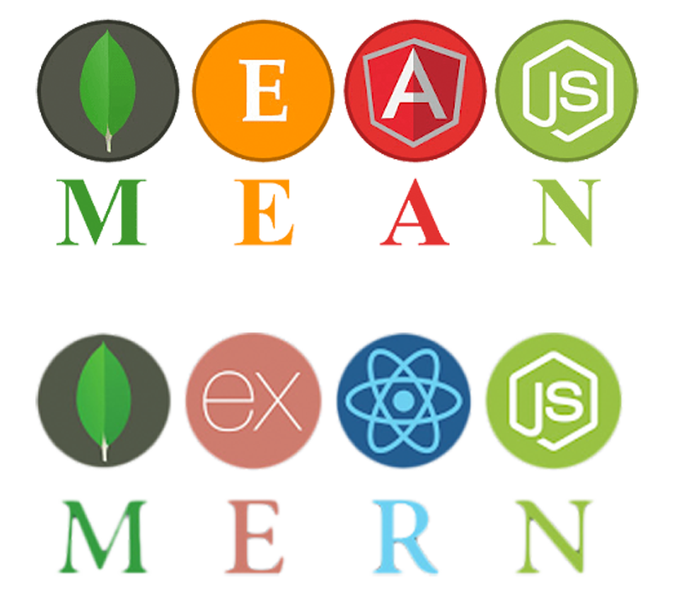
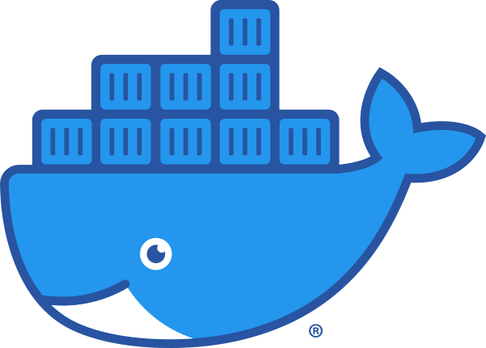




TECH STACK
MERN STACK
DOCKER
HEROKU
MongoDB - Data Store
Express - Server
React JS - Frontend
Node JS - Backend
Deployment Management
Cloud Web Hosting
ERC1155 TOKEN
SOLIDITY
OPENZEPPELIN
Smart Contract
Language
Token representing ownership of asset
Token and Upgradeable Contracts Library

Slide 13
MINIMUM VIABLE PRODUCT
To Date
Validated
KYC/AML
User Dashboard
Monitor
Get Transactions
Onboard
Asset Owner
Marketplace
Monitor
Review
Participate
Create
Validated
Review
Create Asset
Asset Detail
Invest
Onboard
KYC/AML
Pay Owner
Invest
Investor
Deal structure
Initiate
Allot Token
Trade in secondary market
Exchange or Swap
Platform Admin
Issue Token
Participate
Issue Token
Legal service
Valuation service
Create Token
List
Legends
Web App
Smart Contract
Manual Process
Actors
External Actors
Mint Token
USDT
Distribute
RE Manager
Admin Dashboard
Distribute Income
Distribute
Manage
RE Operation
Income
MVP Functions

Slide 14
LASIC PRINCIPLES
01
Low cost of adoption for consumers
Use of technology to find untapped markets
01
LOW MARGIN
Attract & build critical mass
02
INNOVATIVE
Disruptive, Inclusive and Solves real problems
02
Ride on existing infrastructure
01
ASSET LIGHT
02
Collaboration instead of bundling of services
Great likelihood for Government support
01
Expandable w/o exponential cost
01
COMPLIANCE EASY
SCALABLE
Use of existing regulatory frameworks
Technology allows for large scale adoption & changes
02
02

Slide 15
THANKS
Does anyone have any questions?

